Slide 1
CSE 105 theory of computation
Fall 2020 Week 6

Slide 2
Table of Contents – Quickly Jump to a video’s slides
Monday | Wednesday | Friday
Video 72 | Video 80 | Video 84
Video 73 | Video 81 | Video 85
Video 74 | Video 82 | Video 86
Video 75 | Video 83 | Video 87
Video 76 | Examples | Examples
Video 77 | FAQ | FAQ
Video 78
Video 79
Examples
FAQ

Slide 3
This week’s learning goals
Trace the computation of a Turing machine on given input
Describe the language recognized by a Turing machine
Determine if a Turing machine is a decider
Given an implementation-level description of a Turing machine
Describe several variants of Turing machines and informally explain why they are equally expressive.
Define an enumerator
Describe the language enumerated by an enumerator
Use high-level descriptions to define and trace machines (Turing machines and enumerators)
Prove that enumerators and Turing machines are equally expressive
Apply dovetailing in high-level definitions of machines
Define nondeterministic Turing machines
State and use the Church-Turing thesis

Slide 4
Monday
Videos 072-079
Today’s learning goals
Trace the computation of a Turing machine on given input
Describe the language recognized by a Turing machine
Determine if a Turing machine is a decider
Given an implementation-level description of a Turing machine
Today’s textbook sections
Sipser 3.1 Definition 3.5, 3.6 (page 170)

Slide 5
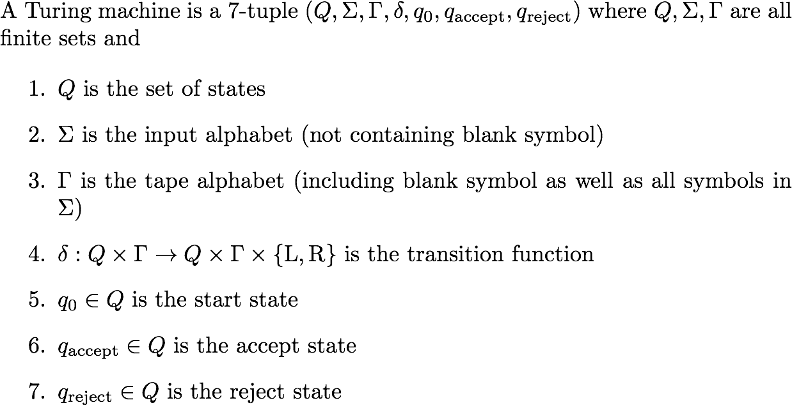
072.CSE105.TuringMachineComplicatedExampleImplementationAndDiagram.mp4
Remember:
q_{reject} ≠ q_{accept}
Definition 3.3, Sipser 3.1, pg.168

Slide 6
A more complicated example
L = { w#w | w is in {0,1}* }
We already know that L is
not regular
not context-free
We will prove that L is
the language of some Turing machine

Slide 7
Implementation-level description
L = { w#w | w is in {0,1}* }
Idea for Turing machine
Zig-zag across tape to corresponding positions on either side of '#' to check whether these positions agree. If they do not, or if there is no '#', reject. If they do, cross them off.
Once all symbols to the left of the '#' are crossed off, check for any un-crossed-off symbols to the right of '#': if there are any, reject; if there aren't, accept.

Slide 8
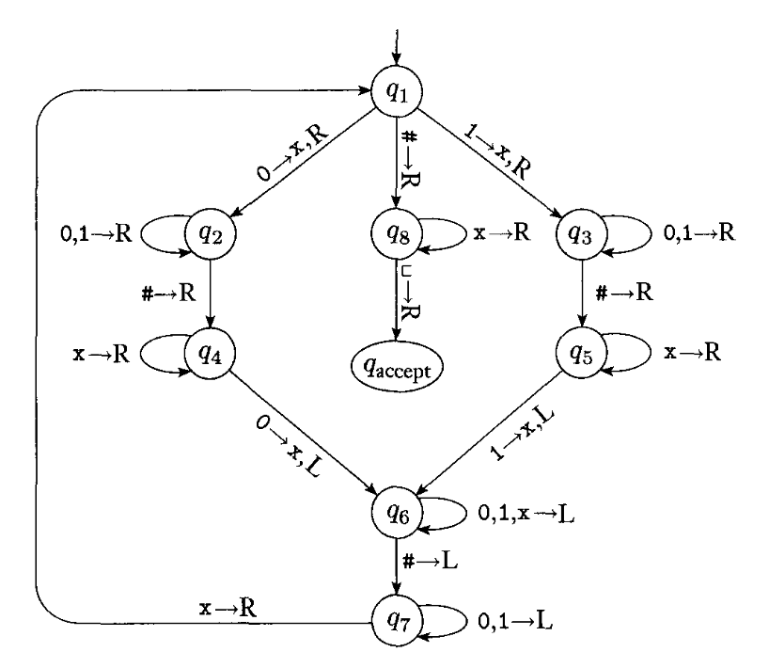

Formal definition
Σ = {0,1,#}
Γ = {0,1,#,x,_ }
Q={q1,q2,q3,q4,q5,q6,q7,q8,q_{accept},q_{reject}}
Shorthand: b→R means b→b, R
All missing transitions have output (q_{reject}, _, R)

Slide 9
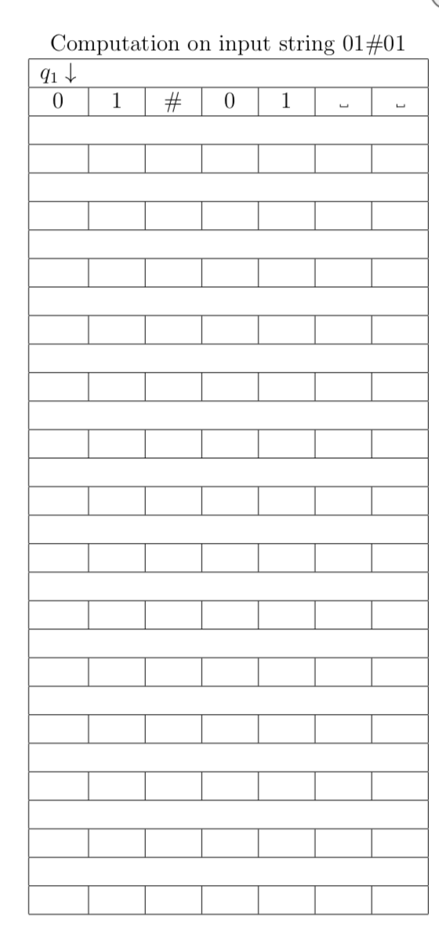





Slide 10
Role of each state

Slide 11
Key Notation and Definitions (072)
Implementation-level definition: English prose to describe the Turing machine head movements relative to the contents of the tape.
0,1→R is the abbreviation for 0→0,R and 1→1,R
For simplicity, all missing transitions have output (q_{reject}, _, R)

Slide 12
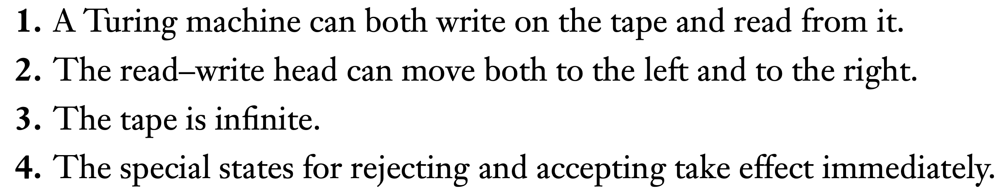
073.CSE105.TuringMachineIntroRecap.mp4
Remember:
Difference between finite automata and Turing machines.
Sipser 3.1, pg. 166

Slide 13
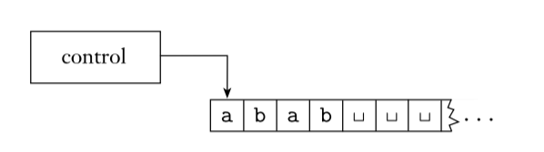
Turing machine computation
Read/write head starts at leftmost position on tape
Input string written on leftmost squares of tape, rest is blank
Computation proceeds according to transition function:
Given current state of machine, and current tape symbol being read, the machine
transitions to next state
writes symbol to current position of the tape head (overwriting existing symbol)
moves the tape head L or R (if possible)
Computation ends if and when machine enters either the accept or the reject state.
L(M) = { w | computation of M on w halts after entering the accept state}
= { w | w is accepted by M}

Slide 14
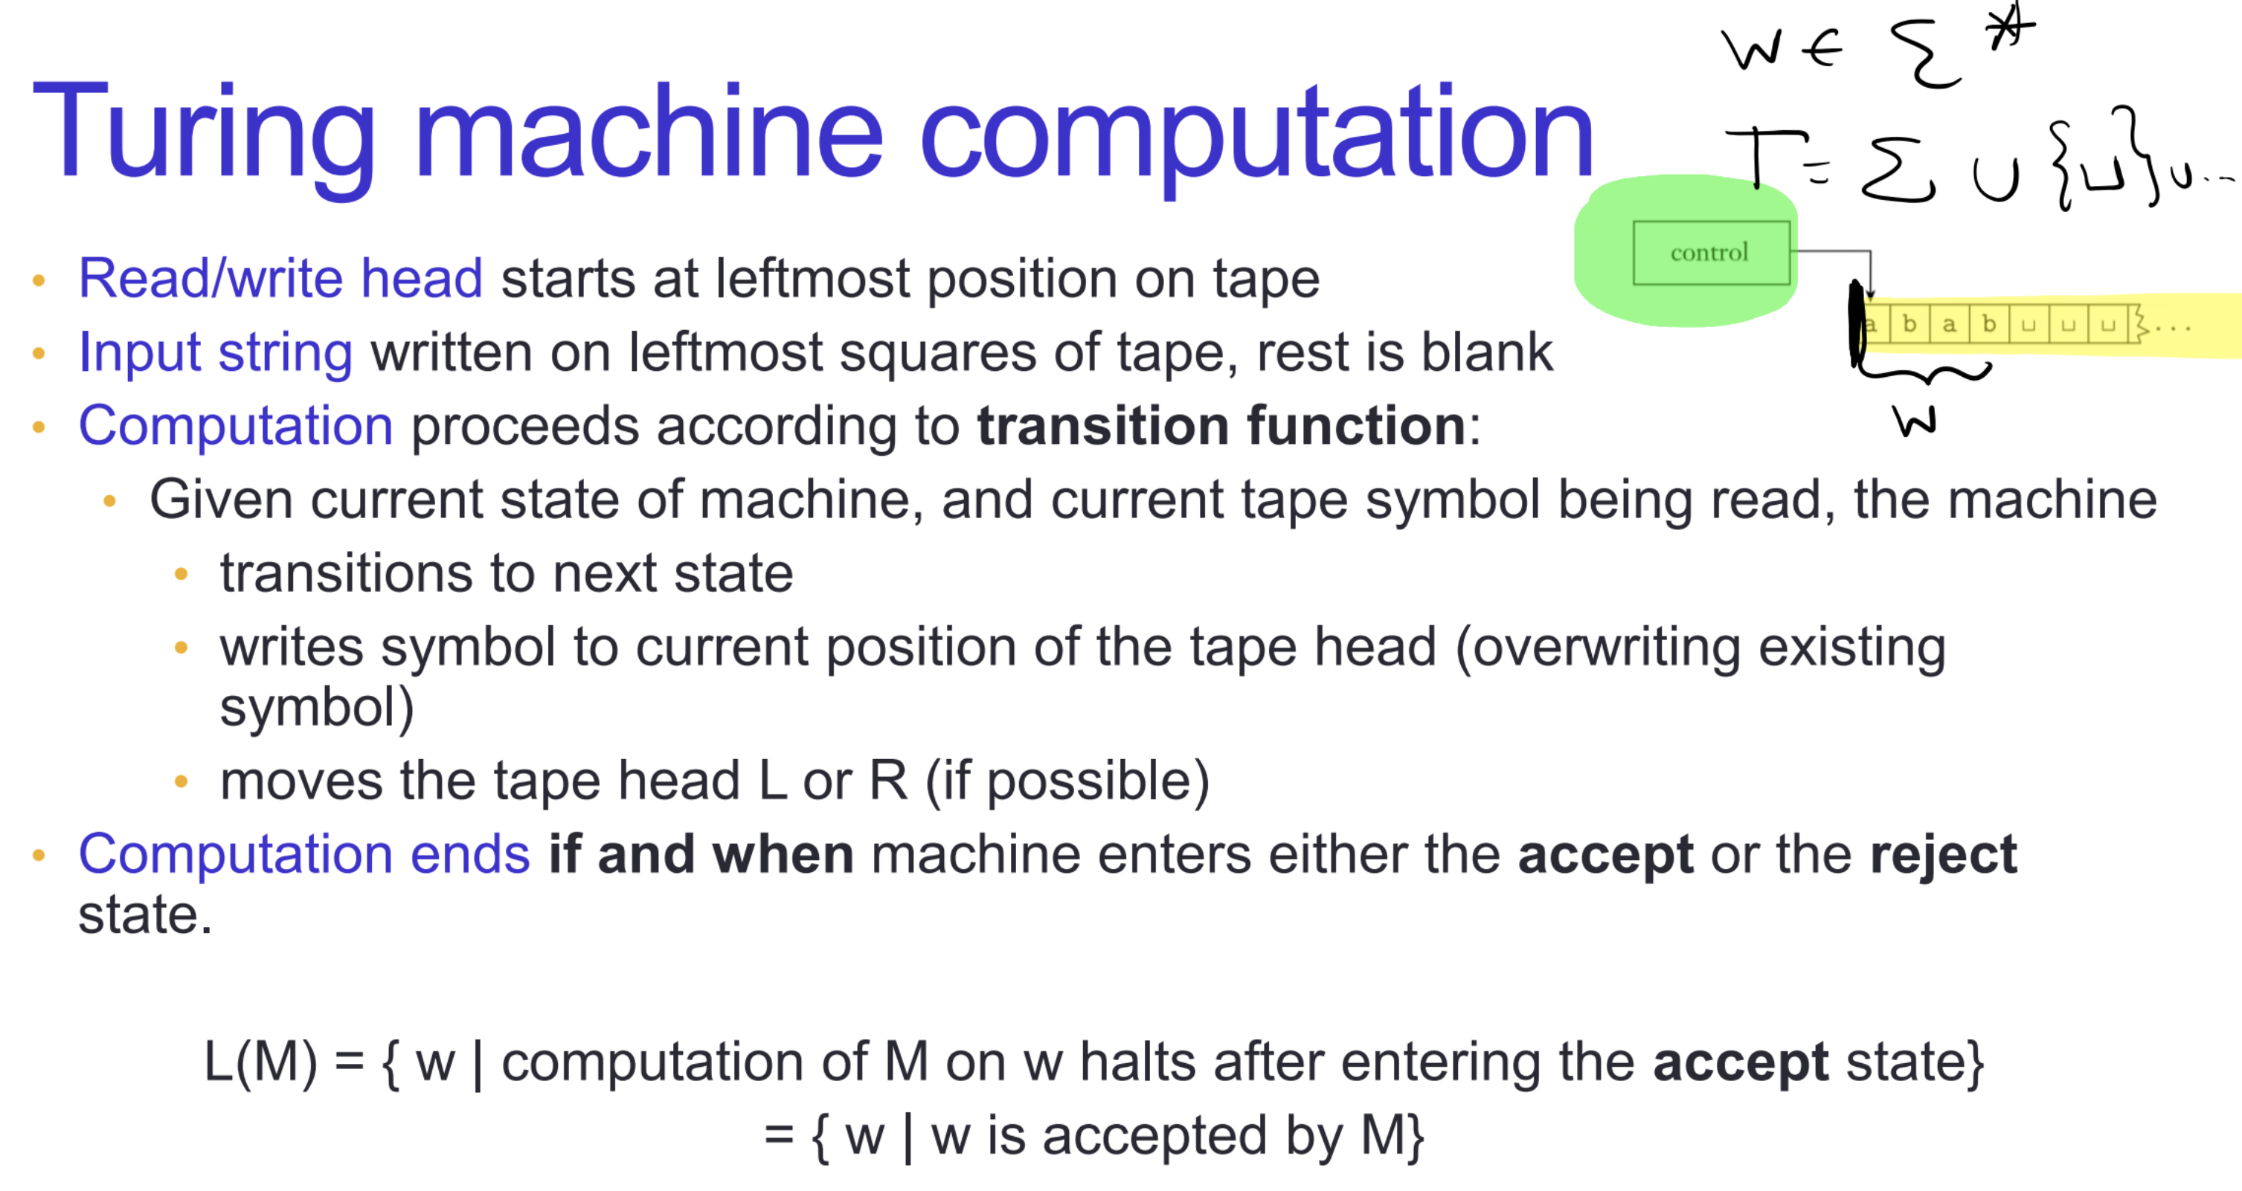

Slide 15
Key Notation and Definitions (073)
A Turing machine computation ends if and when the machine enters either the accept or the reject state (does not need to wait until all inputs symbols are read).
L(M) = { w | computation of M on w halts after entering the accept state}
= { w | w is accepted by M}

Slide 16
074.CSE105.TMAcceptRejectLoop.mp4
Remember:
The computation of M on w halting and rejecting means that the computation enters the reject state.

Slide 17
Language of a TM Sipser p. 170
L(M) = { w | M accepts w}
Which of the following is not always true?
If w is in L(M) then the computation of M on w halts and accepts.
If the computation of M on w halts and rejects, then w is not in L(M).
If w is not in L(M) then the computation of M on w halts and rejects.
More than one of the above.
None of the above.

Slide 18
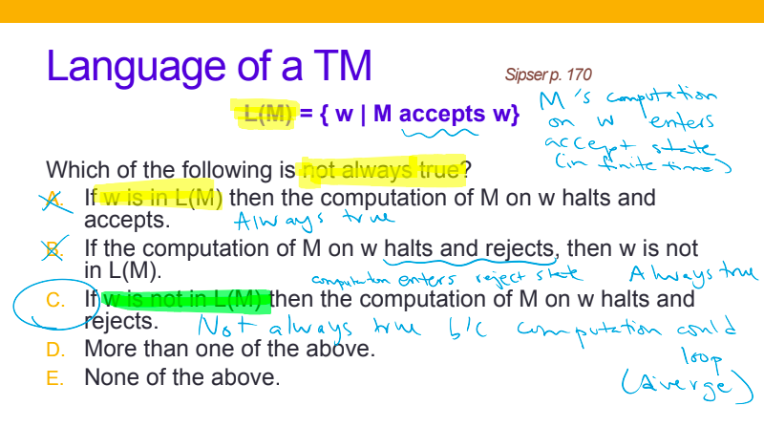

Slide 19
Key Notation and Definitions (074)
For a string w to be in the language recognized by a TM M, by definition, w is a string such that M accepts it. The computation of M on w will halt and accept.

Slide 20
075.CSE105.TMRecognizeVsDecide.mp4
Remember:
L(M) is the set of strings that are each accepted by the machine M (and L(M) contains no other strings).

Slide 21
Deciders and recognizers Sipser p. 170 Defs 3.5 and 3.6
L is recognized by Turing machine M if L(M) = L.
M recognizes L if M is a Turing machine and L(M) = L.
M is a decider if it is a Turing machine and halts on all inputs.
L is decided by Turing machine M if M is a decider and L(M) = L.
M decides L if M is a decider and L(M) = L.

Slide 22
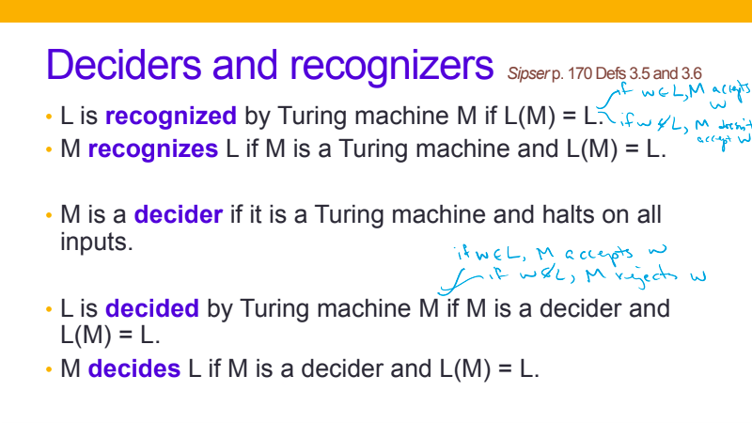

Slide 23
Key Notation and Definitions (075)
If a machine M (infinitely) loops on an input string s, then s is not in the language of M (i.e. L(M)).
If a machine M loops on any possible input string (neither accepts nor rejects the string), M is not a decider.

Slide 24
076.CSE105.TMImplementationLevelAndFormalDefinitionExample1.mp4
Remember:
q_{reject} ≠ q_{accept}
Definition 3.3, Sipser 3.1, pg.168

Slide 25
Describing TMs Sipser p. 184-185
Formal definition: set of states, input alphabet, tape alphabet, transition function, start state, accept state, reject state.
Implementation-level definition: English prose to describe Turing machine head movements relative to contents of tape.

Slide 26
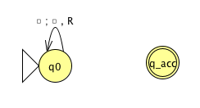
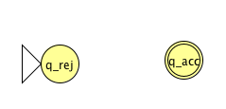
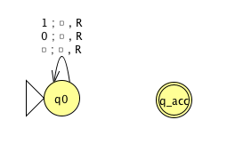
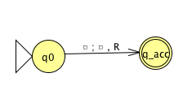

Slide 27
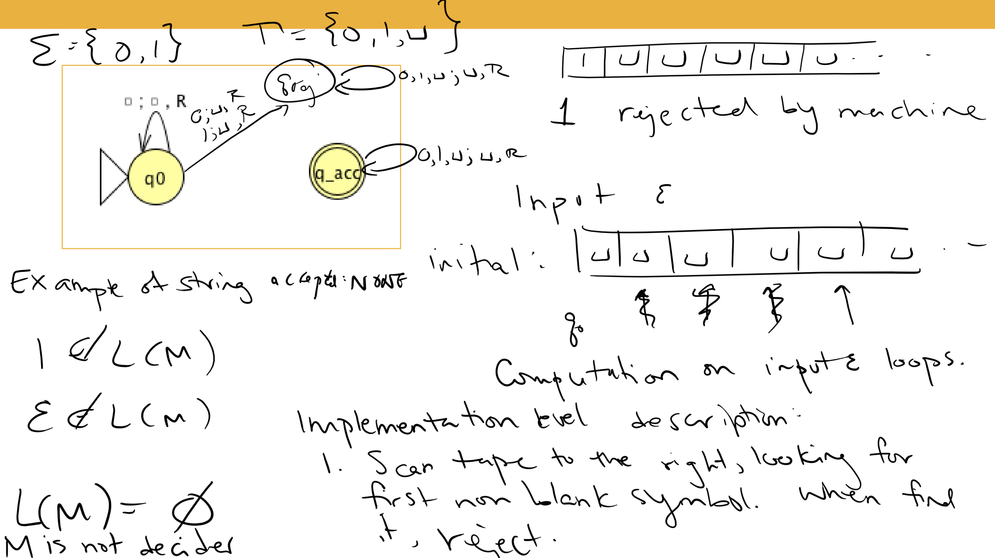

Slide 28
Key Notation and Definitions (076)
Turing machines have a one-way infinite tape.
TMs always keep going until they halt.
If the transition function is well-defined, then the machine always has a next step.
Therefore, TMs can loop forever.

Slide 29
077.CSE105.TMImplementationLevelAndFormalDefinitionExample2.mp4
Remember:
M is a decider if it is a Turing machine and halts on all inputs.

Slide 31
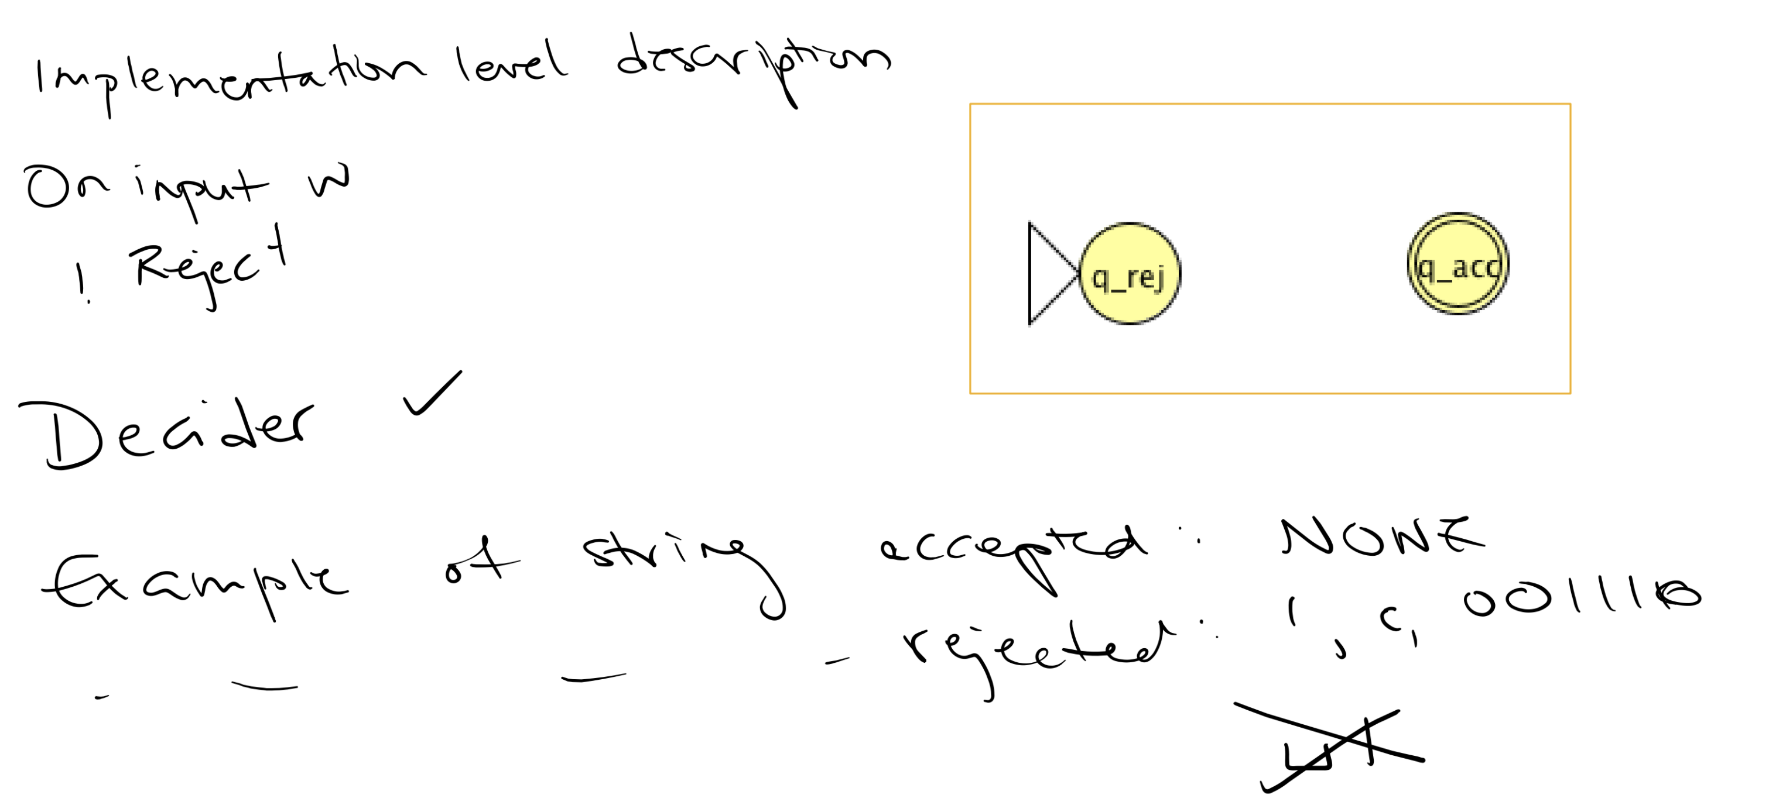
All computation halts before we even start

Slide 32
Key Notation and Definitions (077)
Tape alphabet ≠ input alphabet

Slide 33
078.CSE105.TMImplementationLevelAndFormalDefinitionExample3.mp4
Remember:
L is decided by a Turing machine M if M is a decider and L(M) = L.
M decides L if M is a decider and L(M) = L.

Slide 35
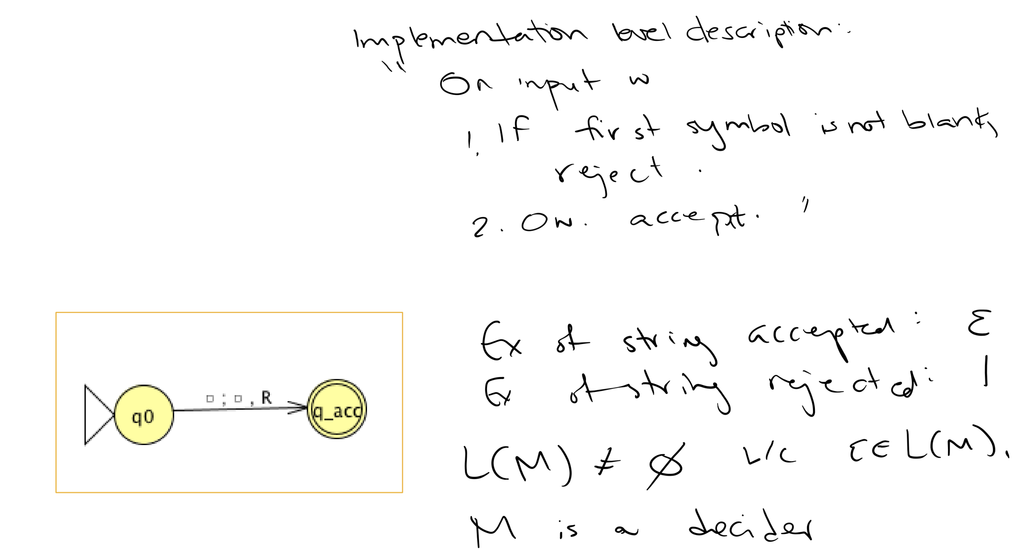

Slide 36
Key Notation and Definitions (078)
Empty string ε has no symbols in the string, so its length is 0.
There is only one empty string because strings need to have different lengths or sequence of symbols to be considered different.

Slide 37
079.CSE105.RecognizableAndDecidableLanguages.mp4
Remember:
Regular Language | Regular expression | DFA/NFA
Context-free Language | Context-free grammar | PDA

Slide 38
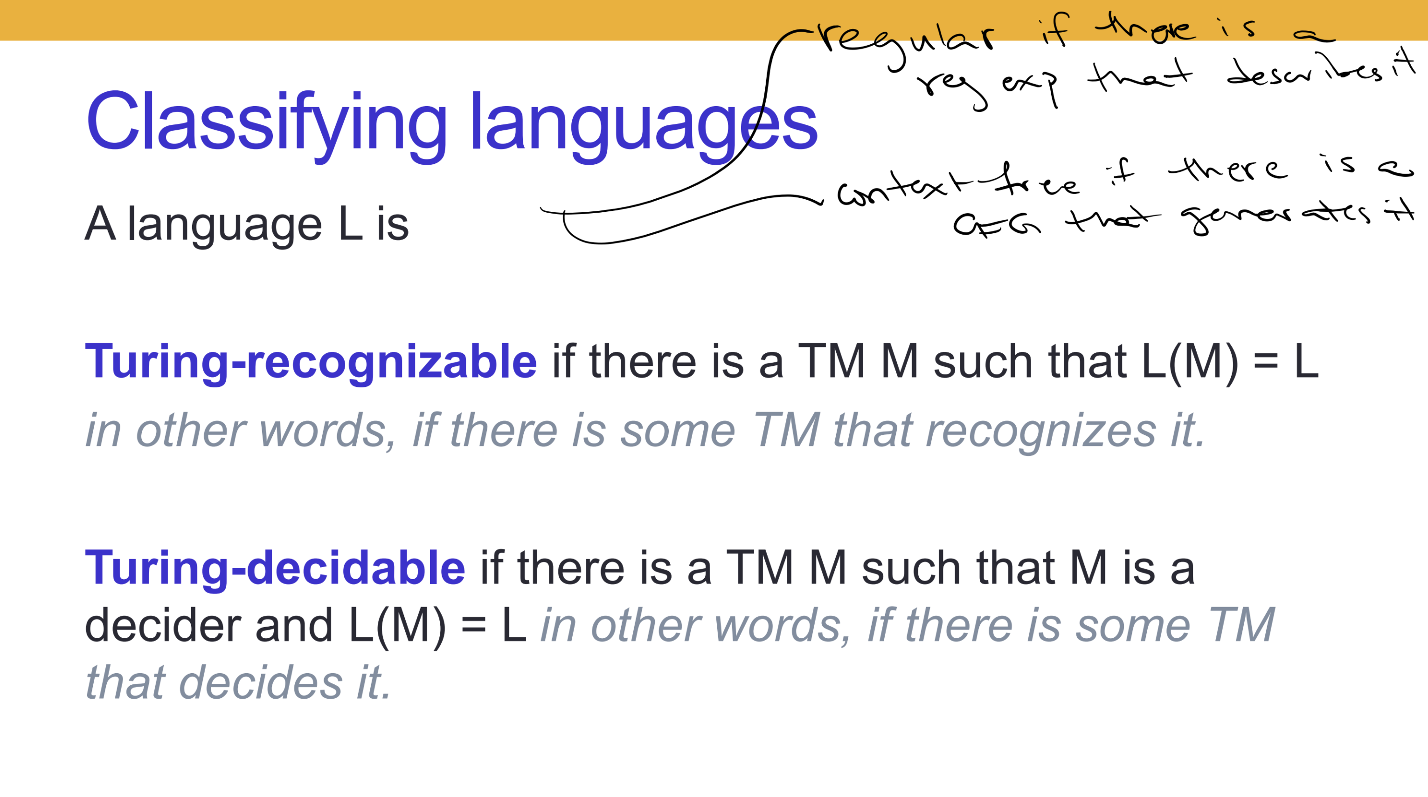
Classifying languages
A language L is
Turing-recognizable if there is a TM M such that L(M) = L
in other words, if there is some TM that recognizes it.
Turing-decidable if there is a TM M such that M is a decider and L(M) = L in other words, if there is some TM that decides it.

Slide 39
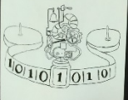
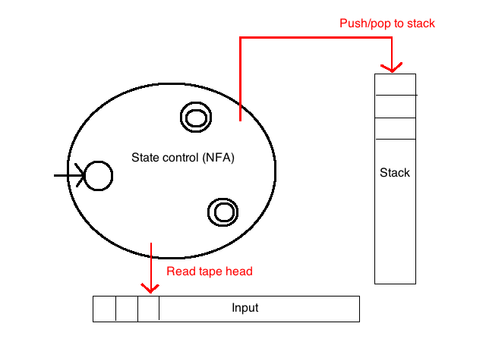
Turing recognizable languages
Turing decidable languages
Context-free languages
Regular languages

Slide 40
To think about
Given a DFA, how would you simulate it with a TM?
Given an NFA, how would you simulate it with a TM?
Given a PDA, how would you simulate it with a TM?

Slide 41
Key Notation and Definitions (079)
A language L is regular if there is a regular expression that describes it.
A language L is context-free if there is a CFG that generates it.
A language L is Turing-recognizable if there is some TM that recognizes it.
A language L is Turing-decidable if there is some TM that decides it.

Slide 42
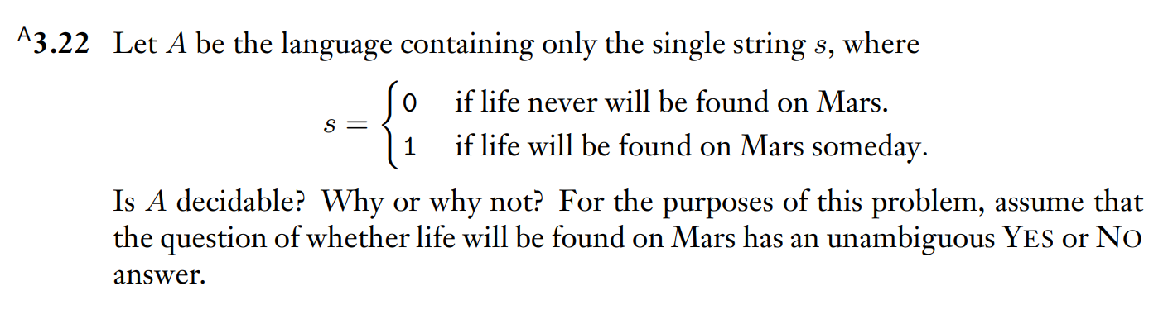
Is this language decidable?
Example 1
Ch. 3 Problems pg. 190

Slide 43
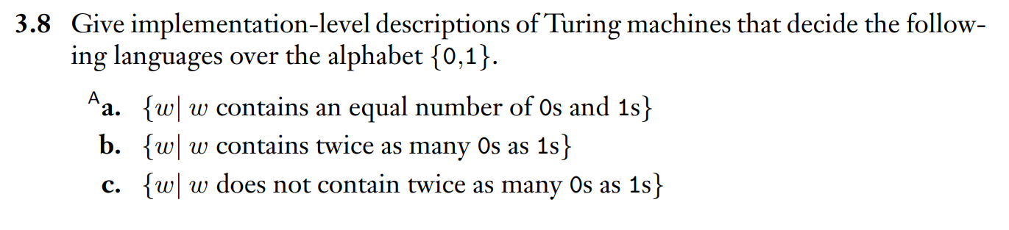
Implementation-level TM descriptions
Example 2
Ch. 3 Exercises pg. 188

Slide 44
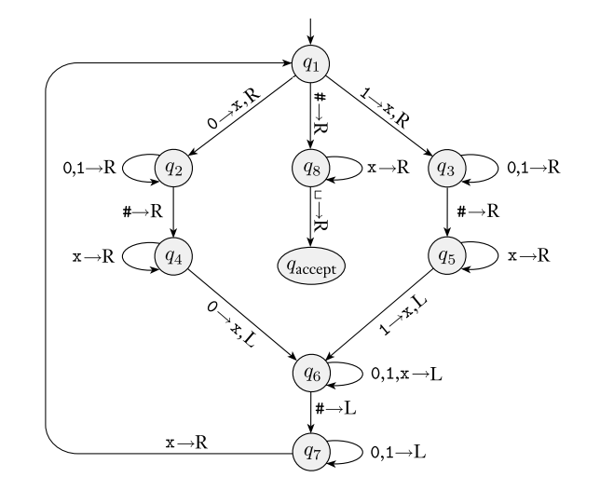
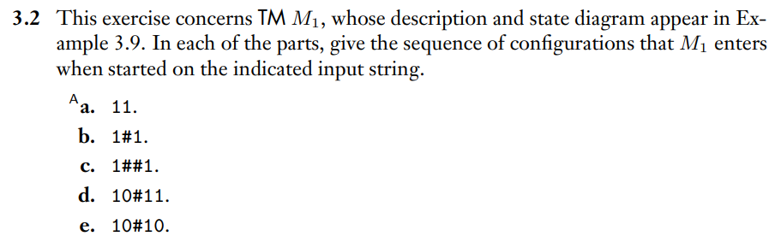
Tracing the computation of another TM
Example 3
TM, M1 from Example 3.9 for reference
Ch. 3 Exercises pg. 188

Slide 45
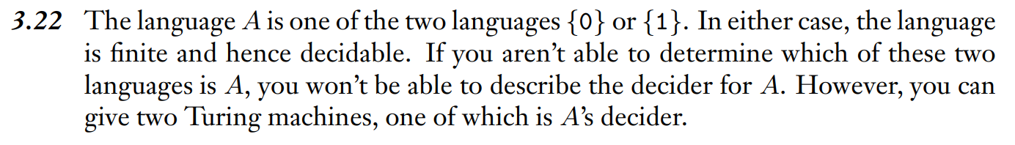
Example 1 Solution
Ch. 3 Solutions pg. 191

Slide 46
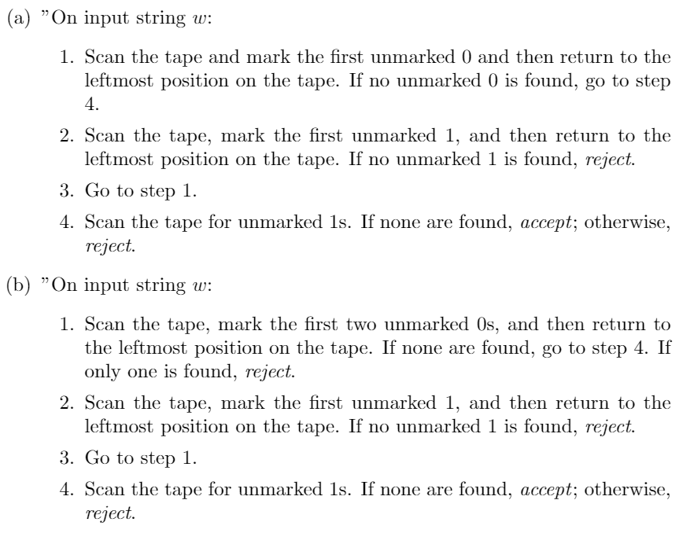
Example 2 Solution

Slide 47
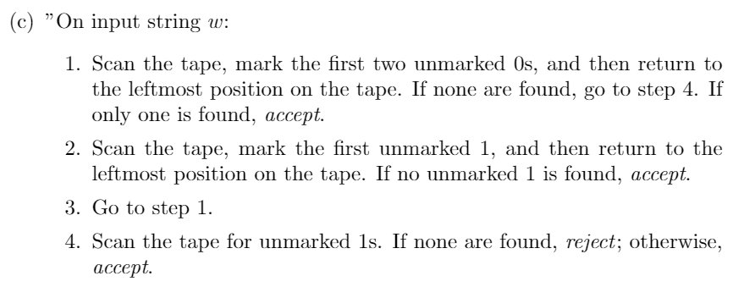
Example 2 Solution(cont.)
Note that the answer for part c is the same as part b except the accept and reject states have been reversed.

Slide 48
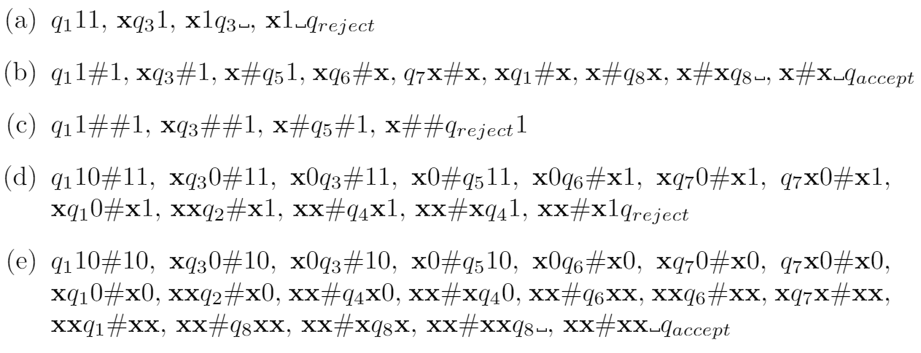
Example 3 Solution

Slide 49
Monday FAQ (072-079)
Q: "In a transition, can we move the position of the tape more than 1 spot to the left or the right? Is it possible to not move at all?"
A: No, we can only move the position of the tape exactly 1 spot to the left or to the right, as indicated by an L or an R.

Slide 50
Wednesday
Videos 080-083
Today’s learning goals
Describe several variants of Turing machines and informally explain why they are equally expressive.
Define an enumerator
Describe the language enumerated by an enumerator
Use high-level descriptions to define and trace machines (Turing machines and enumerators)
Prove that enumerators and Turing machines are equally expressive
Today’s textbook sections
Sipser 3.2 pp. 176-77 (multi-tape machines)

Slide 51
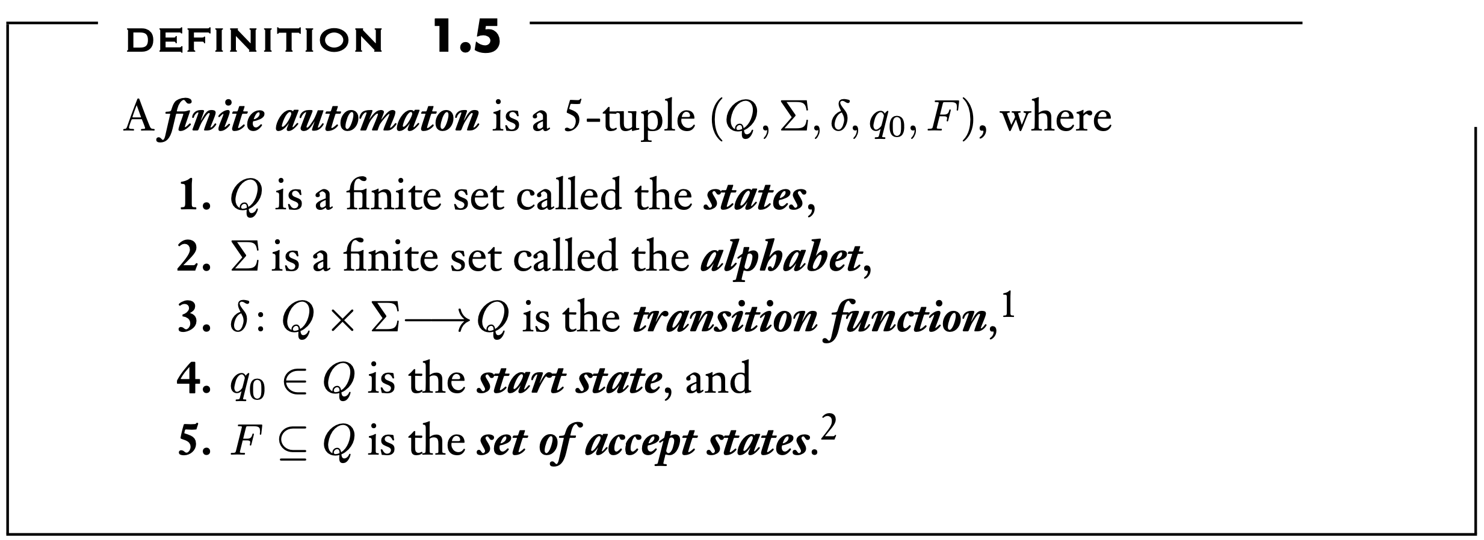
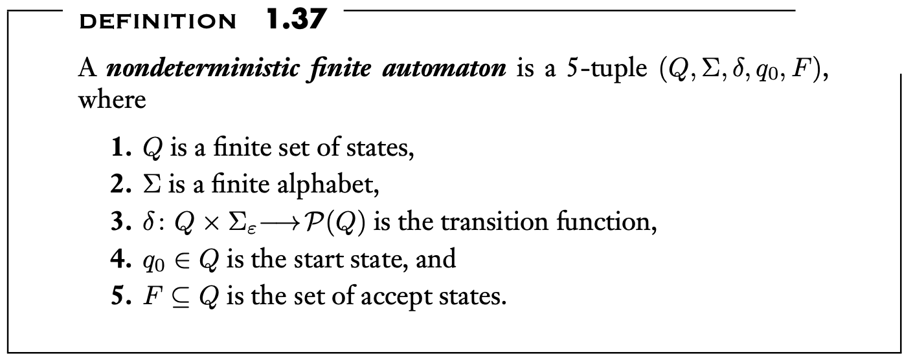
080.CSE105.RegularLanguagesAreDecidable.mp4
Remember:
Sipser, Pg. 35, section 1.1
Sipser, Pg. 53, section 1.2

Slide 52
To think about
Given a DFA, how would you simulate it with a TM?
Given an NFA, how would you simulate it with a TM?
Given a PDA, how would you simulate it with a TM?
Challenges:
TMs are deterministic
TMs have only one accept state

Slide 53
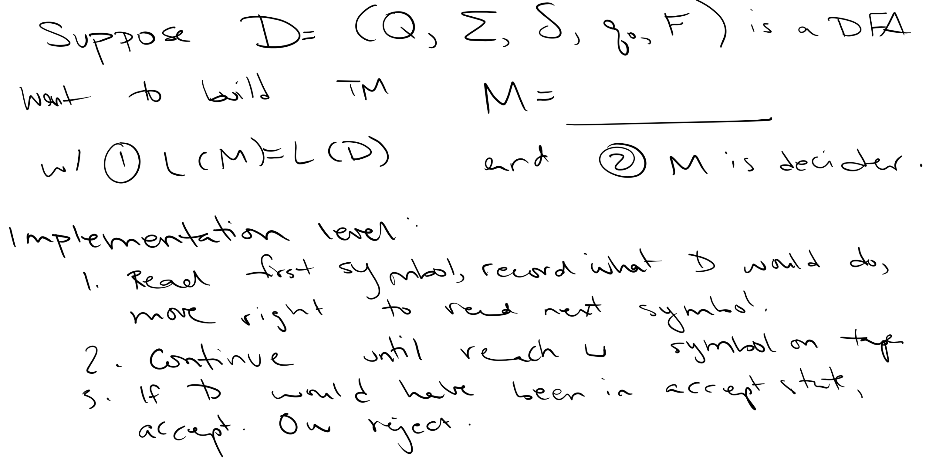

Slide 54
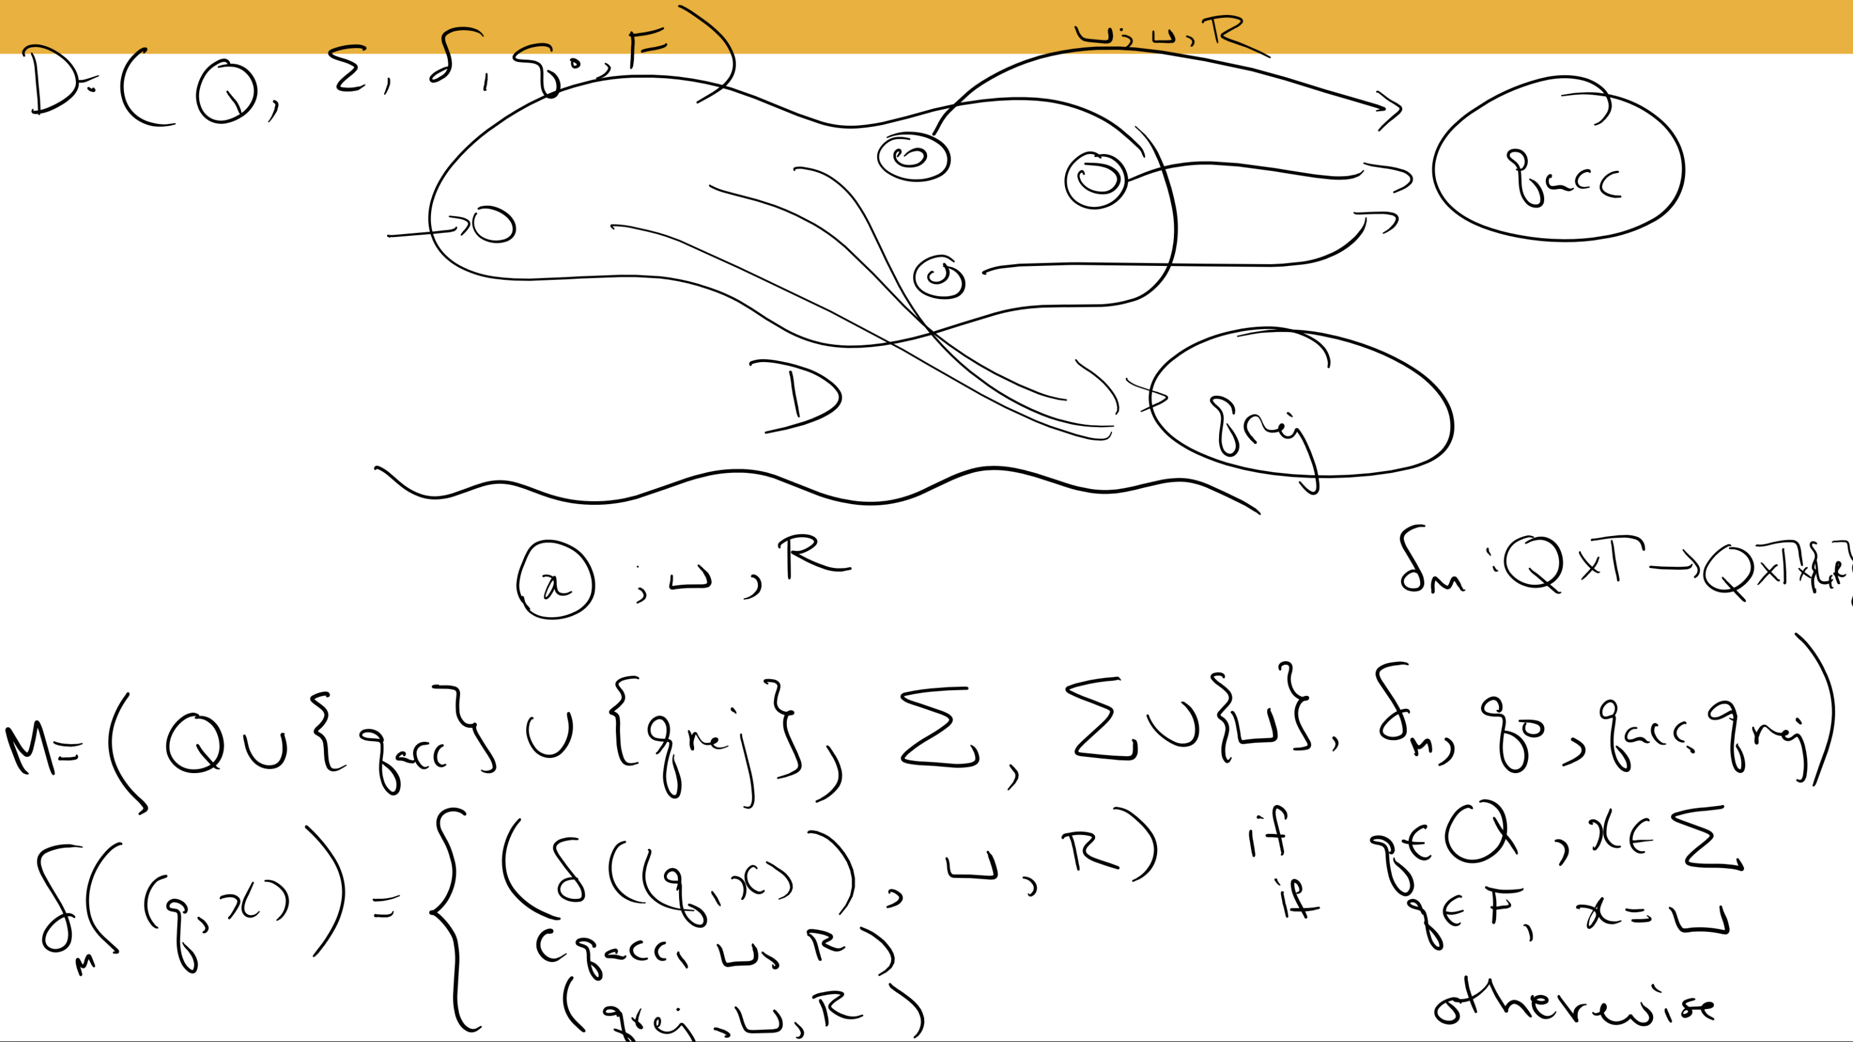

Slide 55
Key Notation and Definitions (080)
Simulate a DFA with Turing machine
Process the input symbols and keep going right.
If we reach a blank symbol “_”, we’ve reached the end of the input.
If we’re in an accept state, we accept. Otherwise reject.

Slide 56
081.CSE105.EquallyExpressiveModels.mp4
Remember:
Theorem in chapter 1(equivalence of DFA and NFA)
A language L is recognizable by some DFA iff L is recognizable by some NFA.

Slide 57
Arbitrary choices?
Why do we move the read-write head L/R at each step
Why one-way infinite tape?
Why special q_{acc}, q_{rej} instead of F?
Why not “jump to address”? Or jump multiple steps?
Why 1-dimensional memory?
Why deterministic? PDA, NFA have nondeterminism
Why recognize a language by checking inputs instead of producing it? CFG let us produce strings

Slide 58
"Equally expressive"
Model 1
Model 2
Model 1 is equally expressive as Model 2 iff every language recognized by a Model 1 machine is recognizable by a Model 2 machine, and every language recognized by a Model 2 machine is recognizable by a Model 1 machine.
Which of the following statements is true?
NFAs and PDAs are equally expressive because they may both be nondeterministic.
PDAs and Turing machines are equally expressive because they can both write (to a stack or the tape).
NFAs and DFAs are equally expressive because they both recognize regular sets.
More than one of the above.
None of the above.

Slide 59
Key Notation and Definitions (081)
Model 1 is equally expressive to Model 2 if and only if
Every language recognized by a Model 1 machine is recognizable by a Model 2 machine
and
Every language recognized by a Model 2 machine is recognizable by a Model 1 machine.

Slide 60
082.CSE105.TMvsMayStayMachines.mp4
Remember:
q_{reject} ≠ q_{accept}

Slide 61
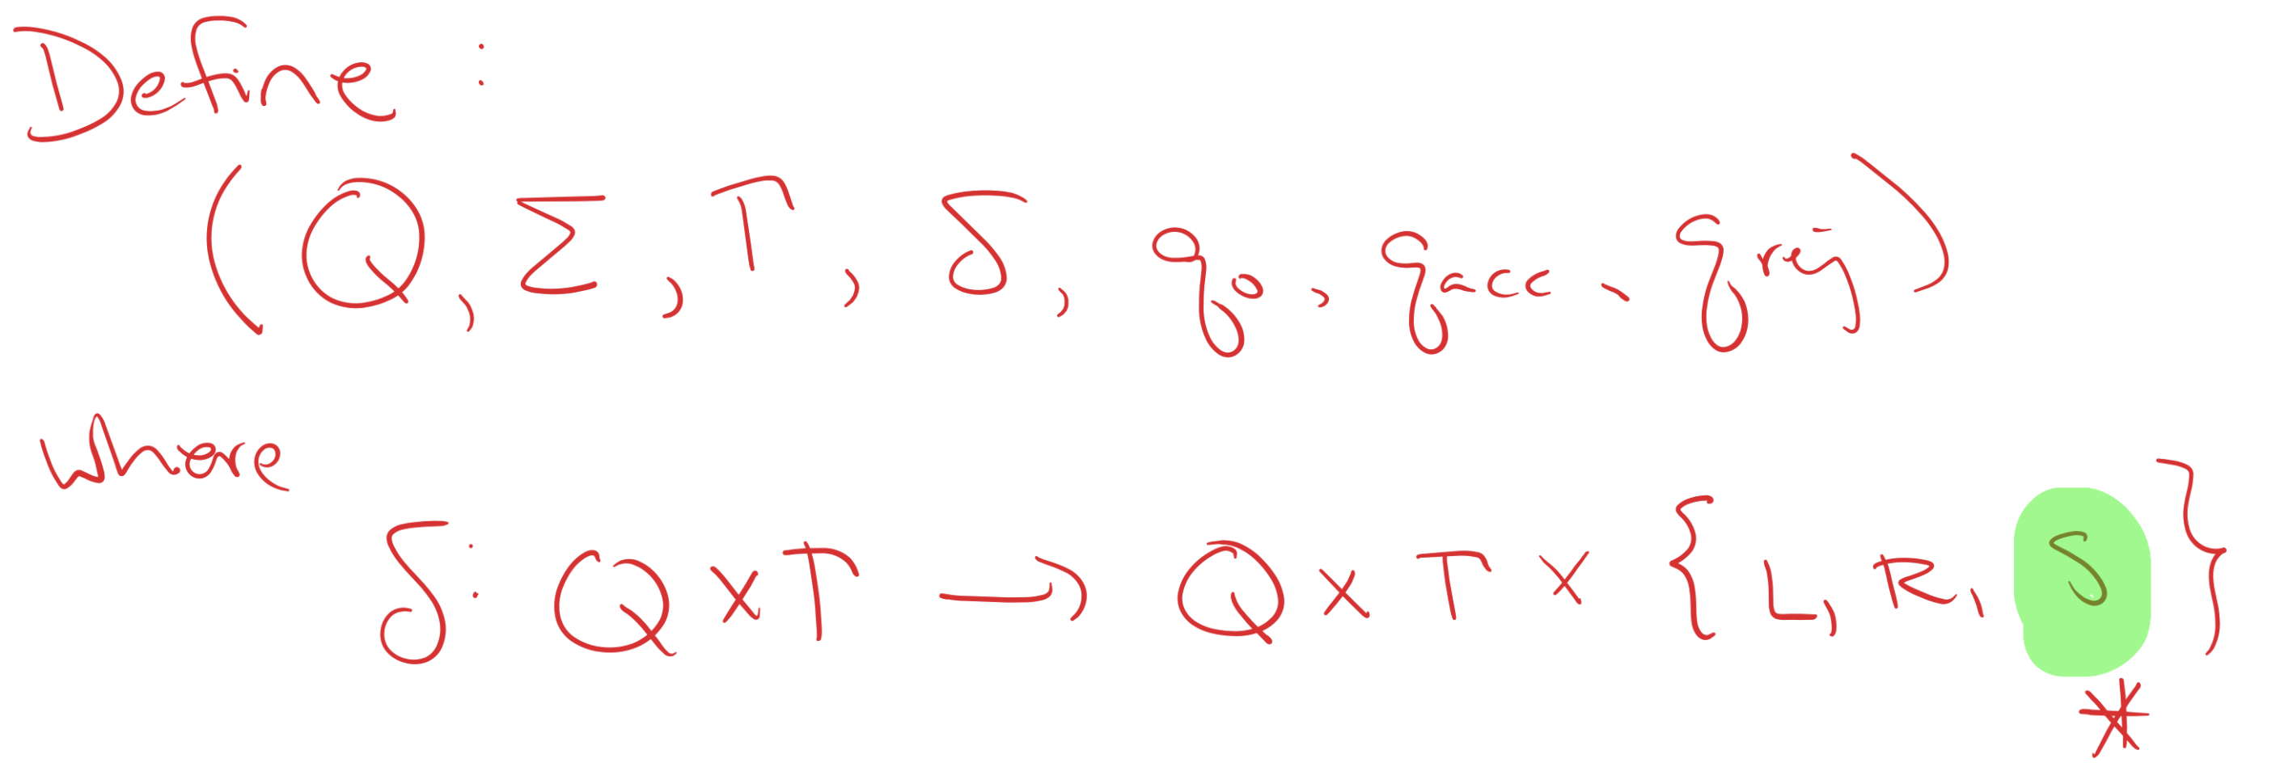
May-stay machines
Same as usual Turing machine model, except that on each transition, the tape head may move L, move R, or Stay

Slide 62
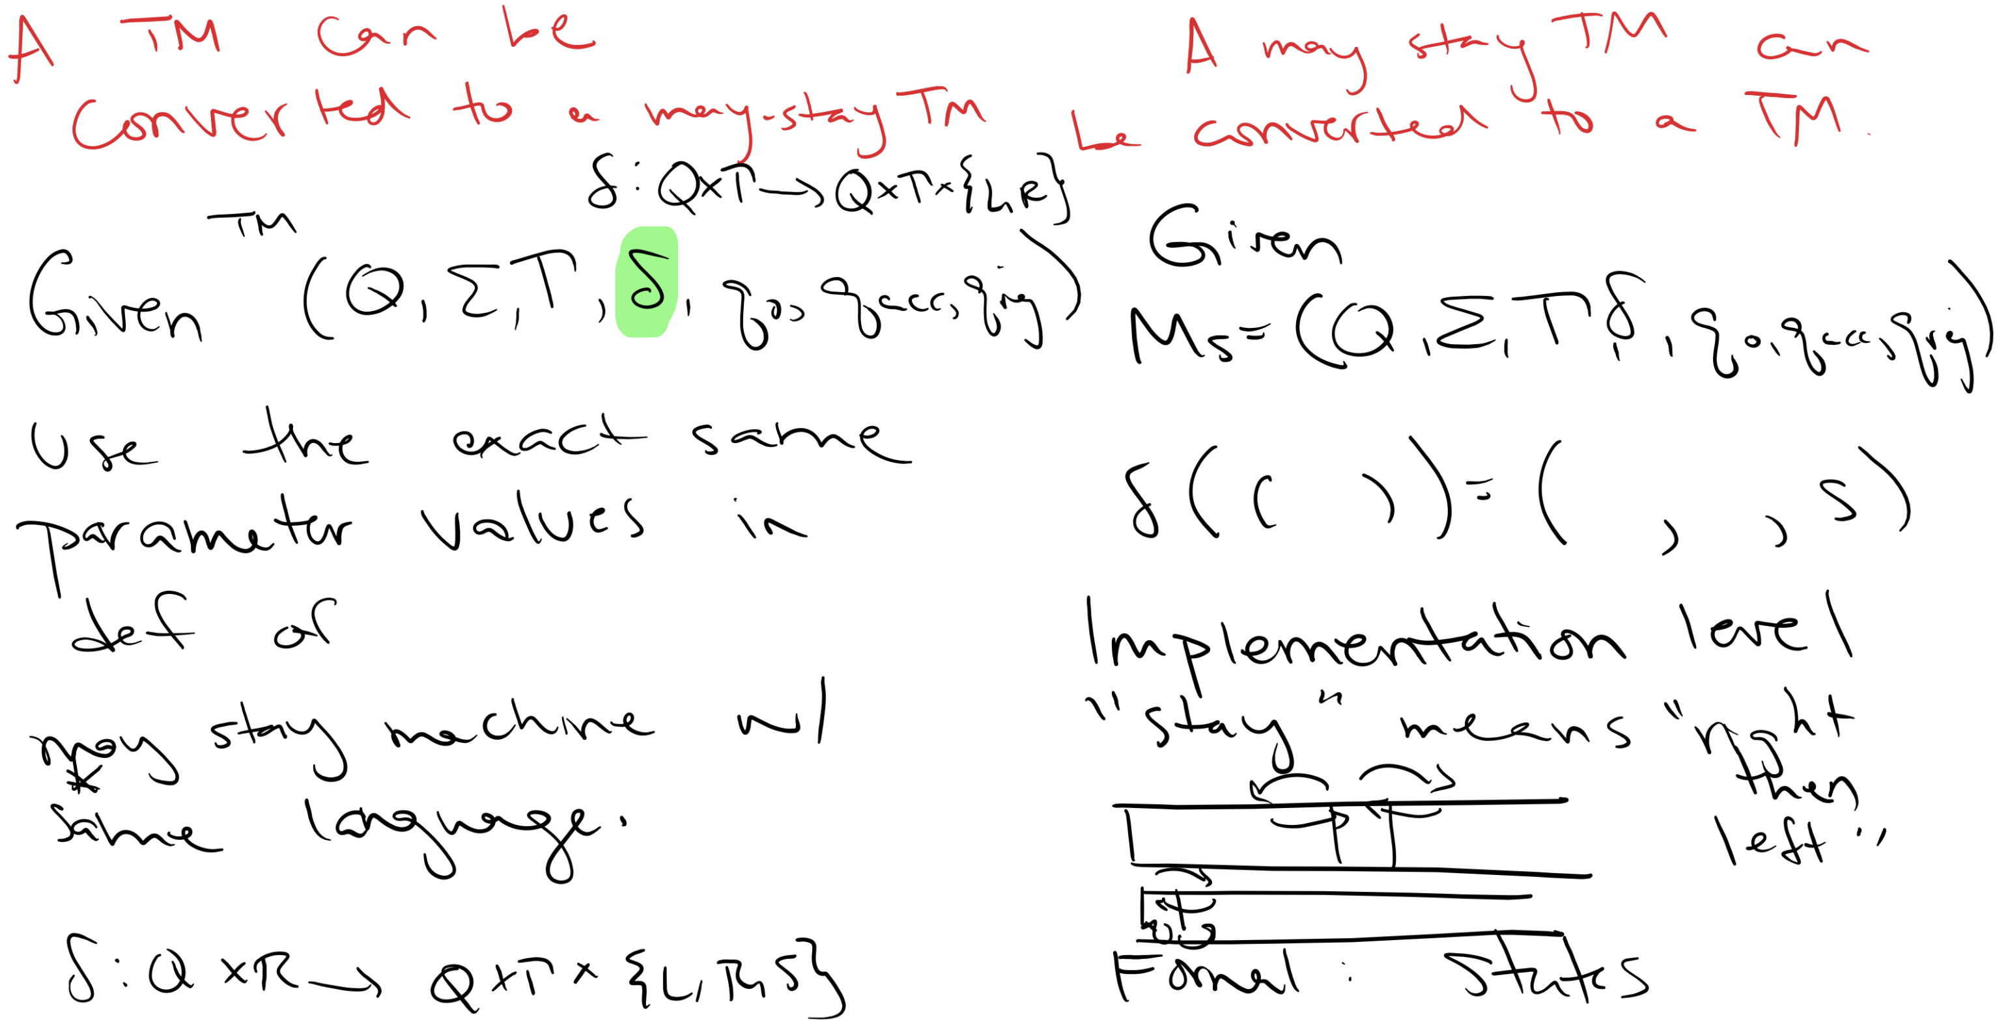

Slide 63
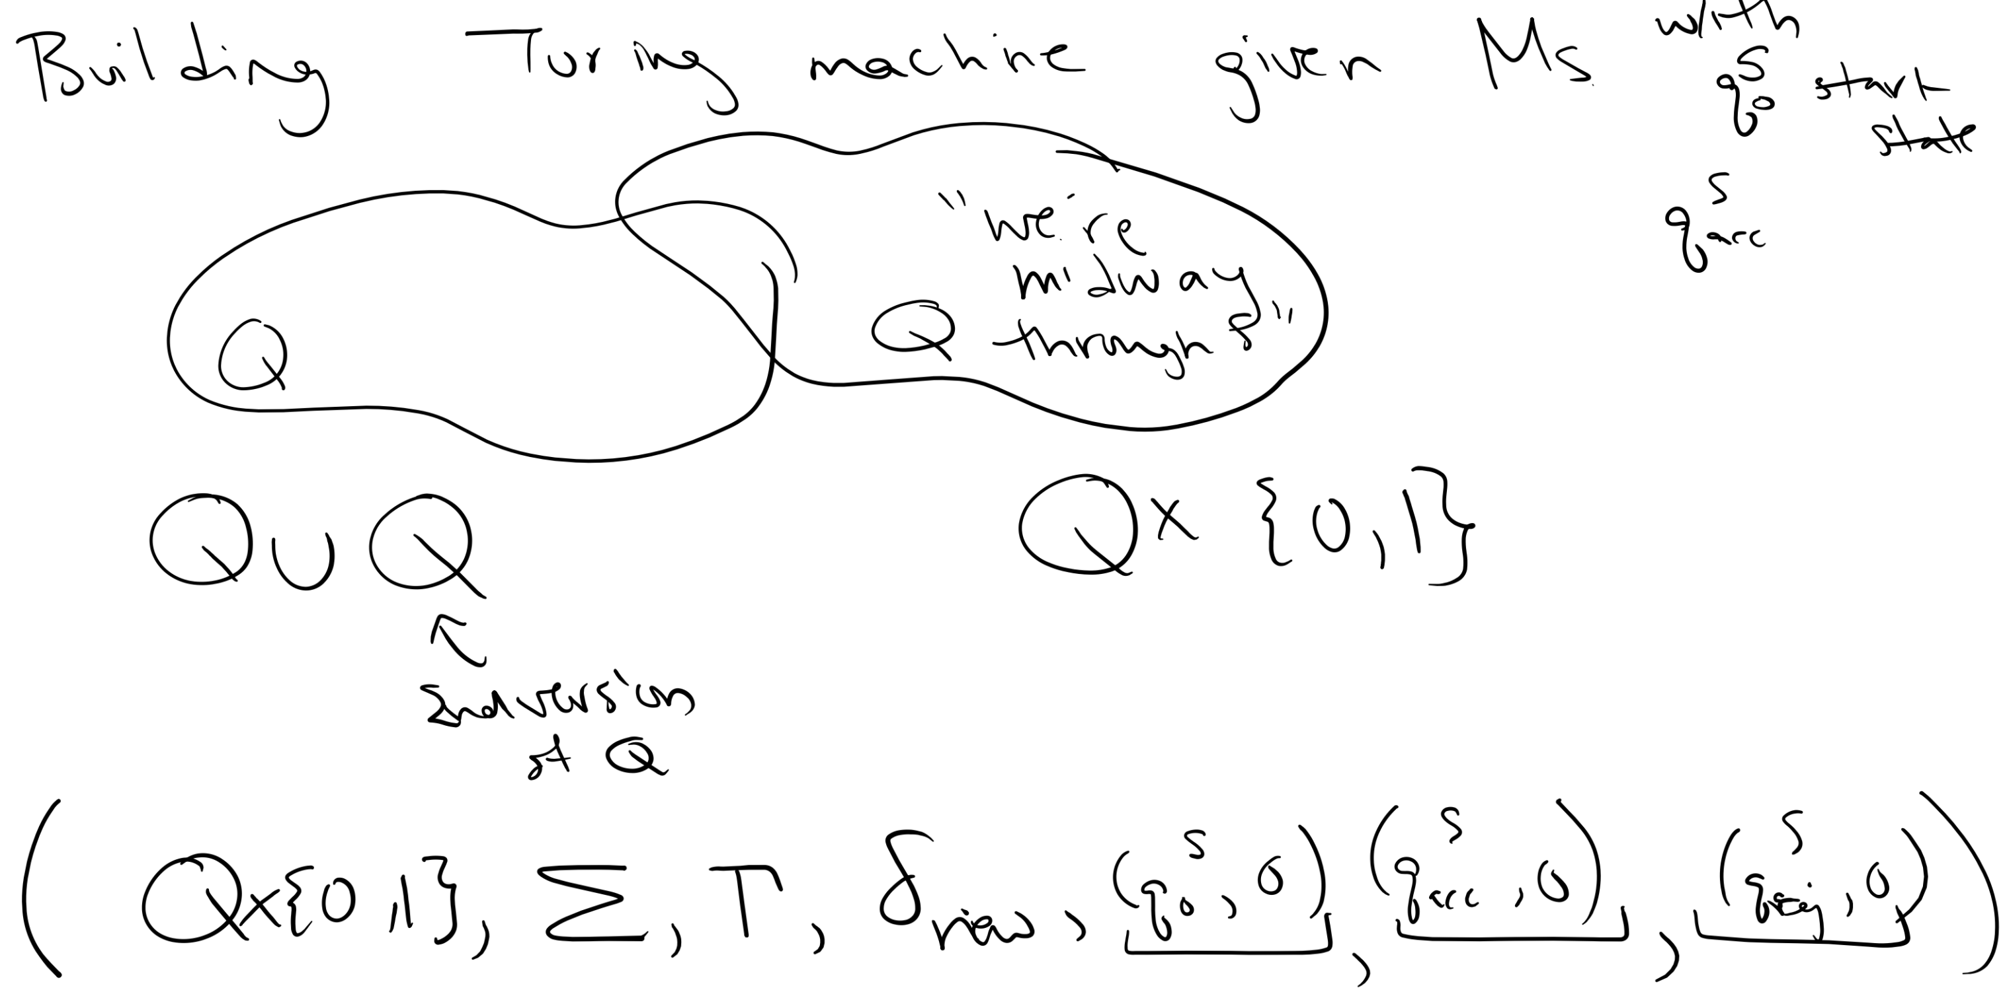

Slide 64
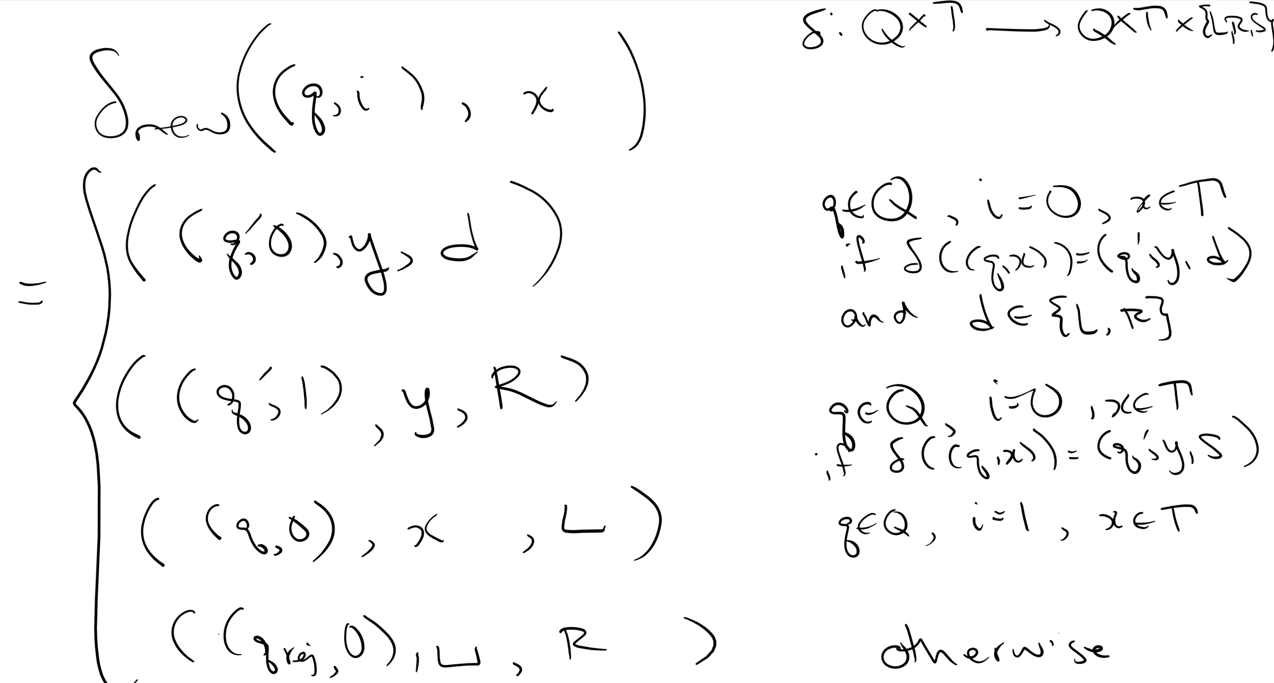

Slide 65
Key Notation and Definitions (082)
A may-stay machine’s tape head may move L, R, or Stay.
A TM can be converted to a may-stay machine.
A may-stay machine can be converted to a TM.

Slide 66
083.CSE105.MultitapeTMs.mp4

Slide 67
Multitape TMs Sipser p. 176
As part of construction of machine, declare some finite number of tapes that are available.
Input given on tape 1, rest of the tapes start blank.
Each tape has its own read/write head.
Transition function
Q x Γ^{k} → Q x Γ^{k} x {L,R,S}^{k}
Sketch of proof of equivalence:
To simulate multiple tapes with one tape: Use delimiter to keep tape contents separate, use special symbol to indicate location of each read/write head.

Slide 68
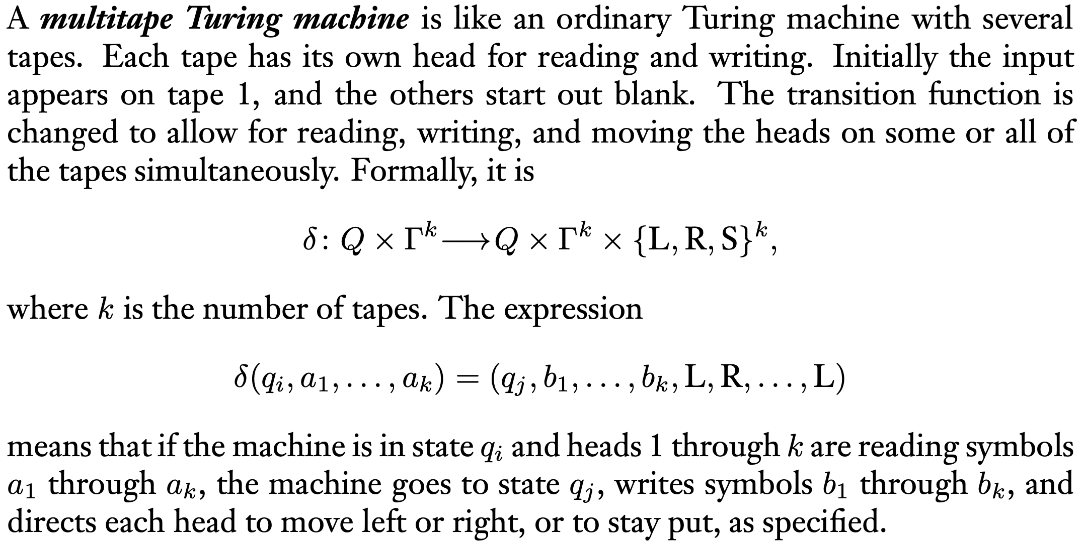
Key Notation and Definitions (083)
Section 3.2, pg.176

Slide 69
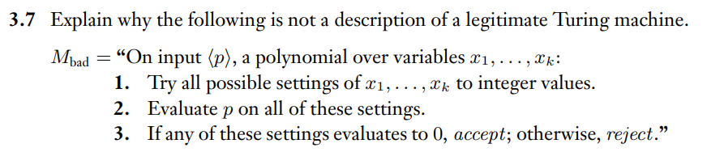
A Bad Description of TM
Example 1
Ch. 3 Exercises pg. 188

Slide 70
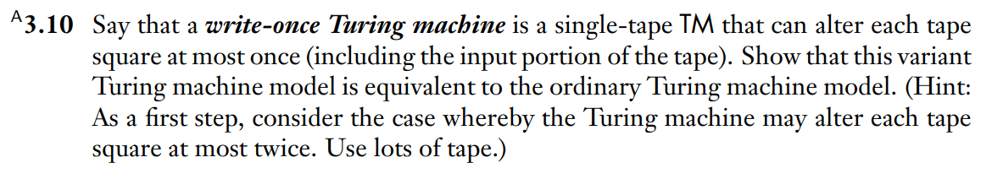
A write-once TM
Example 2
Ch. 3 Problems pg. 188

Slide 71
Example 1
The problem is in the last line: where the algorithm says "otherwise, reject". This is impossible because there are infinitely many possible settings of the variables to integer values, so we will not be able to, in finite time, determine the truth value of the conditional test "do any of these settings evaluate to 0?"

Slide 72
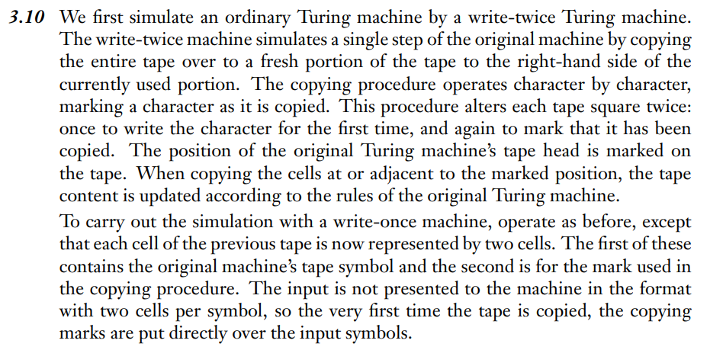
Example 2 Solution
Ch. 3 Solutions pg. 191

Slide 73
Wednesday FAQ (080-083)
Q: "What is the difference between a regular Turing Machine and a May Stay machine?"
A: A Turing Machine will always either move to the left or to the right on the tape during a transition, but a May Stay machine can either move to the left, to the right, or stay at the same point on the tape.
Q: "Since we must move either left or right during a transition in a Turing machine, how can we simulate staying at the same point on the tape, like we can in a May Stay machine?"
A: We would move to the right and then back to the left, and during these transitions, we would not change anything on the tape.

Slide 74
Friday
Videos 084-087
Today’s learning goals
Apply dovetailing in high-level definitions of machines
Define nondeterministic Turing machines
State and use the Church-Turing thesis
Today’s textbook section
Sipser 3.2 pp.181-182 (equivalence with other models)

Slide 75
084.CSE105.NondeterministicTMs.mp4
Remember:
Multi-tape TMs (or nondeterministic TMs) appear to be more powerful than ordinary Turing machines, but they’re equivalent in the language that they recognize.

Slide 76
"Equally expressive"
Model 1
Model 2
Model 1 is equally expressive as Model 2 iff every language recognized by a Model 1 machine is recognizable by a Model 2 machine, and every language recognized by a Model 2 machine is recognizable by a Model 1 machine.
Turing machines are equally expressive to
May-stay machines and other variants, e.g. two-sided tape, F instead of q_{acc}
Multi-tape machines
Enumerators

Slide 77
Nondeterministic TMs Sipser p. 178
At any point in the computation, machine may proceed according to several possibilities. Accept if at least one computation path leads to accept state.
Transition function
Q x Γ → P(Q x Γ x {L,R})
Sketch of proof of equivalence:
To simulate nondeterministic machine: Use 3 tapes to do breadth-first search of computation tree: "read-only" input tape, simulation tape, tape tracking nondeterministic branching.

Slide 78
Church-Turing Thesis Sipser p. 183
Scratch work, copy input, … Multiple tapes
Parallel computation Nondeterminism
Printing vs. accepting Enumerators
More flexible transition function
Can "stay put"
Can "get stuck"
Can "goto" cell on tape
lots of examples in exercises to Chapter 3
Also: wildly different models
λ-calculus, Post canonical systems, URMs, etc.
All these models are equally expressive!

Slide 79
Key Notation and Definitions (084)
Church-Turing Thesis: (Alonzo Church & Alan Turing)
A function on the natural numbers can be calculated by an effective method if and only if it is computable by a Turing machine.
Thesis
A statement or theory that is put forward as a premise to be maintained or proved.

Slide 80
085.CSE105.Church-TuringThesis.mp4

Slide 81
Church-Turing Thesis Sipser p. 183
Scratch work, copy input, … Multiple tapes
Parallel computation Nondeterminism
Printing vs. accepting Enumerators
More flexible transition function
Can "stay put"
Can "get stuck"
Can "goto" cell on tape
lots of examples in exercises to Chapter 3
Also: wildly different models
λ-calculus, Post canonical systems, URMs, etc.
All these models are equally expressive!

Slide 82
Key Notation and Definitions (085)
If all these models of computation are equally expressive, then it must be that the notion of an algorithm has been captured.
Algorithm: A sequence of well-defined steps that can each be performed in a finite time.
Anything that is computable is computable with a Turing Machine.

Slide 83
086.CSE105.HighLevelDescriptionsOfTMS.mp4

Slide 84
Describing TMs Sipser p. 184-185
Formal definition: set of states, input alphabet, tape alphabet, transition function, state state, accept state, reject state.
Implementation-level definition: English prose to describe Turing machine head movements relative to contents of tape.
High-level description: Description of algorithm, without implementation details of machine. As part of this description, can "call" and run another TM as a subroutine.

Slide 85
Key Notation and Definitions (086)
Implementation Level Description example
Zig-zag across tape to corresponding positions on either side of '#' to check whether these positions agree. If they do not, or if there is no '#', reject. If they do, cross them off.
Once all symbols to the left of the '#' are crossed off, check for any un-crossed-off symbols to the right of '#': if there are any, reject; if there aren't, accept.
High level Description example
M = “On input z, If |z| < 5, accept. If not, reject.”

Slide 86
087.CSE105.ClosureOfClassOfRecognizableLanguagesUnion.mp4
Remember:
A non-deterministic Turing machine spontaneously moves between its subcomponents.

Slide 87
Application: closure under union
Claim: The union of two Turing-recognizable languages is a Turing-recognizable language.
Proof using Turing machines
Proof using nondeterministic Turing machines
Given two Turing recognizable languages, build TM to recognize their union.

Slide 88
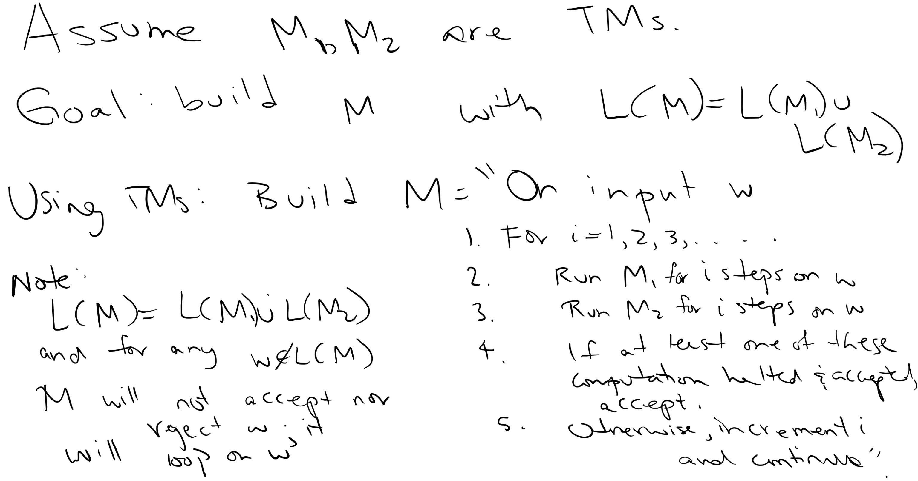

Slide 89
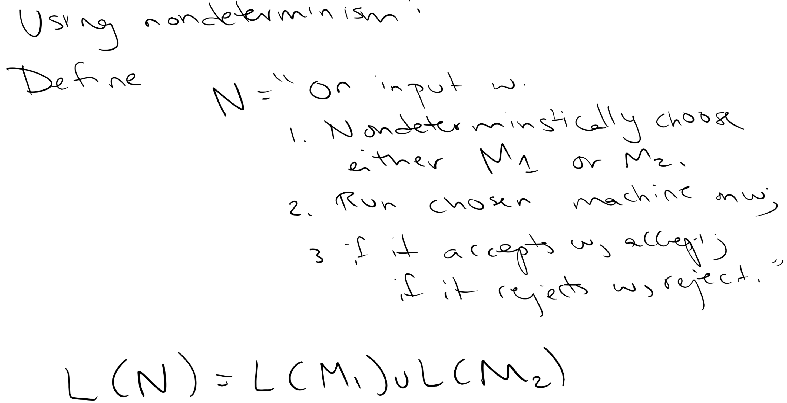

Slide 90
Key Notation and Definitions (087)
With a high-level description, we can use other TMs in our new TM.
Two approach:
Build a new machine M to run M1 and M2 separately. If at least machine (M1 or M2 or both) accepts and halt, then M accepts.
Using non-determinism, build a new machine N that non-deterministically chooses either M1 or M2. If N accepts input w, then accept. Otherwise, reject.

Slide 91
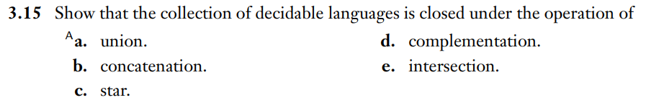
Closure Properties of decidable languages
Example 1
Ch. 3 Problems pg. 189

Slide 92
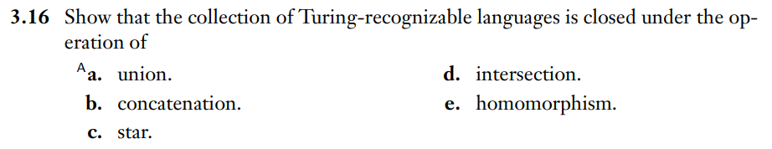
Closure properties of Turing-recognizable languages
Example 2
Ch. 3 Probelms pg. 189

Slide 93
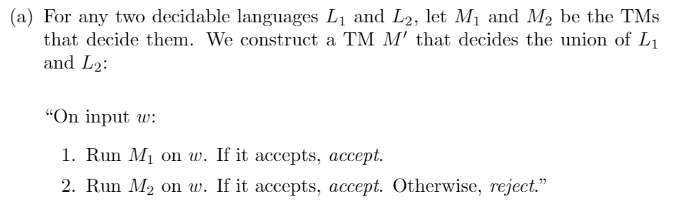
Example 1 Solution

Slide 94
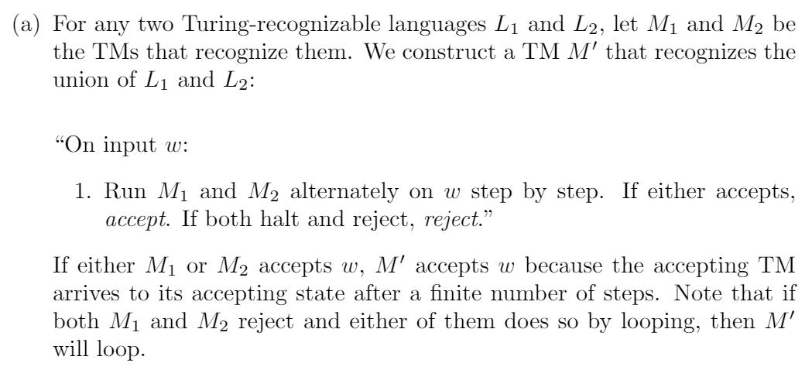
Example 2 Solution

Slide 95
Friday FAQ (084-087)
Q: "What does it mean for a Turing Machine to be 'nondeterministic'?"
A: The definition of nondeterministic Turing machines is in section 3.2 pg.178 of the textbook. Informally, these machines have transition functions that specify a set of possible next moves at each step in the computation. A computation is then formed by picking successive next steps from the allowed ones.

Slide 96
Friday FAQ (084-087) cont.
Q: "How is it possible that we can create Turing Machines that run other Turing Machines inside of them?"
A: Think of it as a parallel to calling methods inside of methods in high-level programming languages like Java and Python. We can write a method in which there is a call to another method we write. With Turing Machines, it is the same idea, having a computation that is represented by another Turing Machine being used as a subroutine of another.

